Slide 1
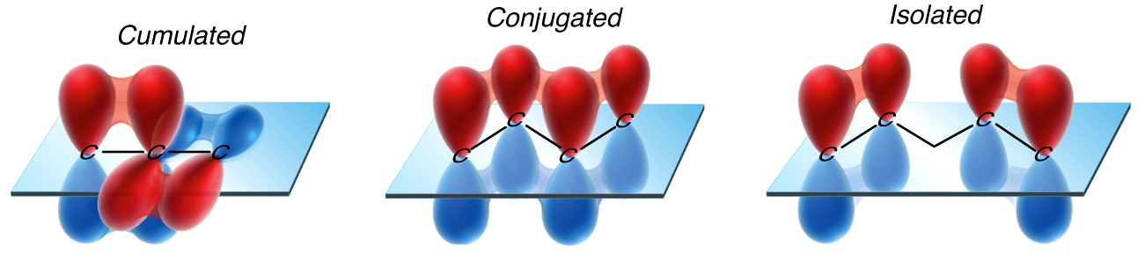
SECTION IV (CHAP 17)
CONJUGATED SYSTEMS AND PERICYCLIC REACTION
bromothymol blue

Slide 2
FUNDAMENTAL CONCEPTS
Stabilization by resonance
1,2 vs 1,4 addition on a conjugated system
Cycloaddition – Diels-Alder reaction
Electrocyclic reaction
Sigmatropic rearrangement
UV spectroscopy

Slide 3
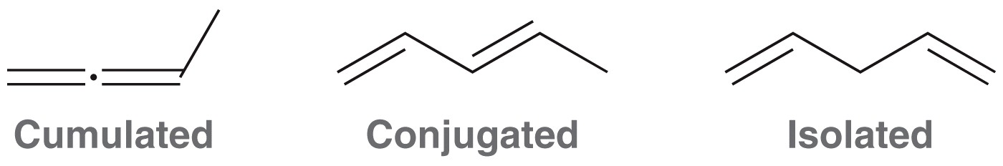
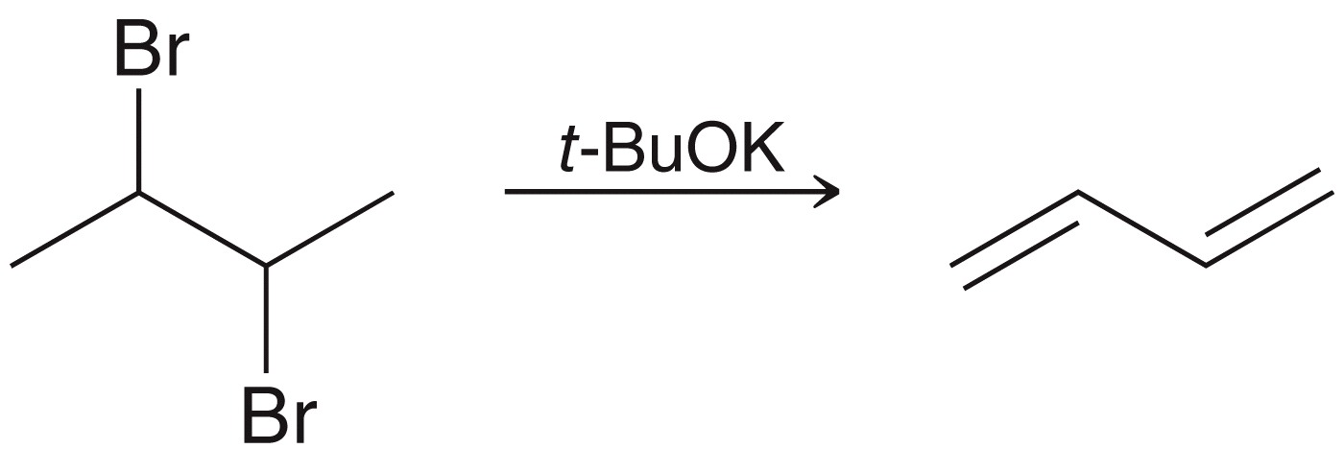
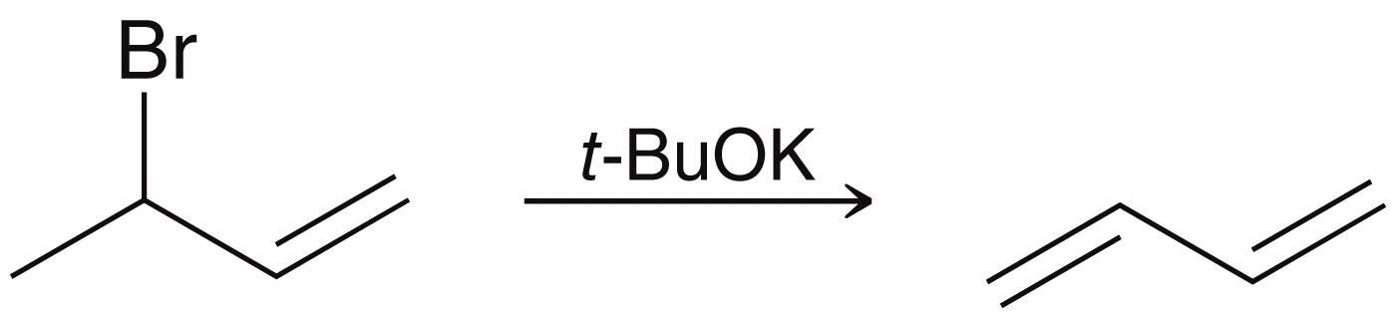
CONJUGATED SYSTEMS
There are three categories for dienes
Cumulated – pi bonds are adjacent
Conjugated – pi bonds are separated by exactly ONE single bond
Isolated – pi bonds are separated by any distance greater than ONE single bond
Practice 17.1 P. 783, 17.4, 17.5 P.785
Problems 17.32 to 17.34 P.826

Slide 4
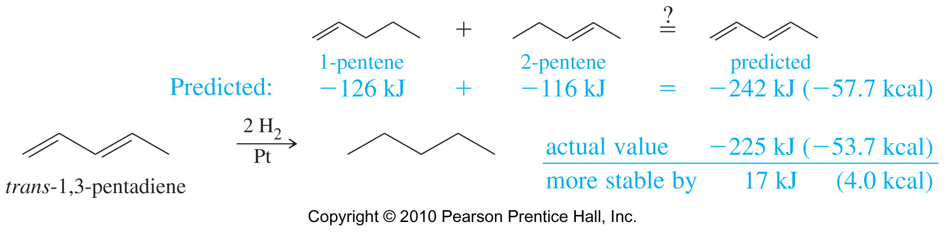
STABILITIES OF DIENES
Heat hydrogenation is often used to compare the relative stabilities of alkenes
For conjugated double bonds, the heat of hydrogenation is less than the sum for the individual double bonds.
The more stable the compound, the less heat released during hydrogenation
Difference, -242 kJ (-225 kJ) = 17 kJ/mol, is the resonance energy, conjugation energy, delocalization energy, and stabilization energy.

Slide 5
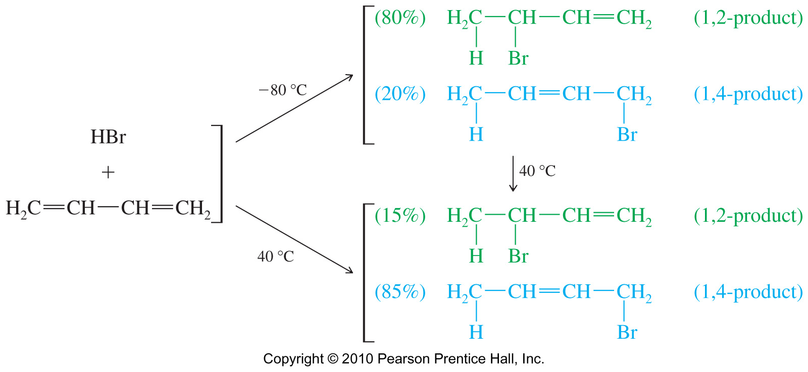
ADDITION TO CONJUGATED DIENES
Electrophilic addition to the double bond produces the most stable intermediate.
For conjugated dienes, the intermediate is a resonance stabilized allylic cation.
Nucleophile adds to either carbon 2 or 4, both of which have the delocalized positive charge
Addition of HBr
Practice 17.7, P. 792, 17.10 to 17.12 P. 795
Problems 17.35 to 17.38 P. 827

Slide 6
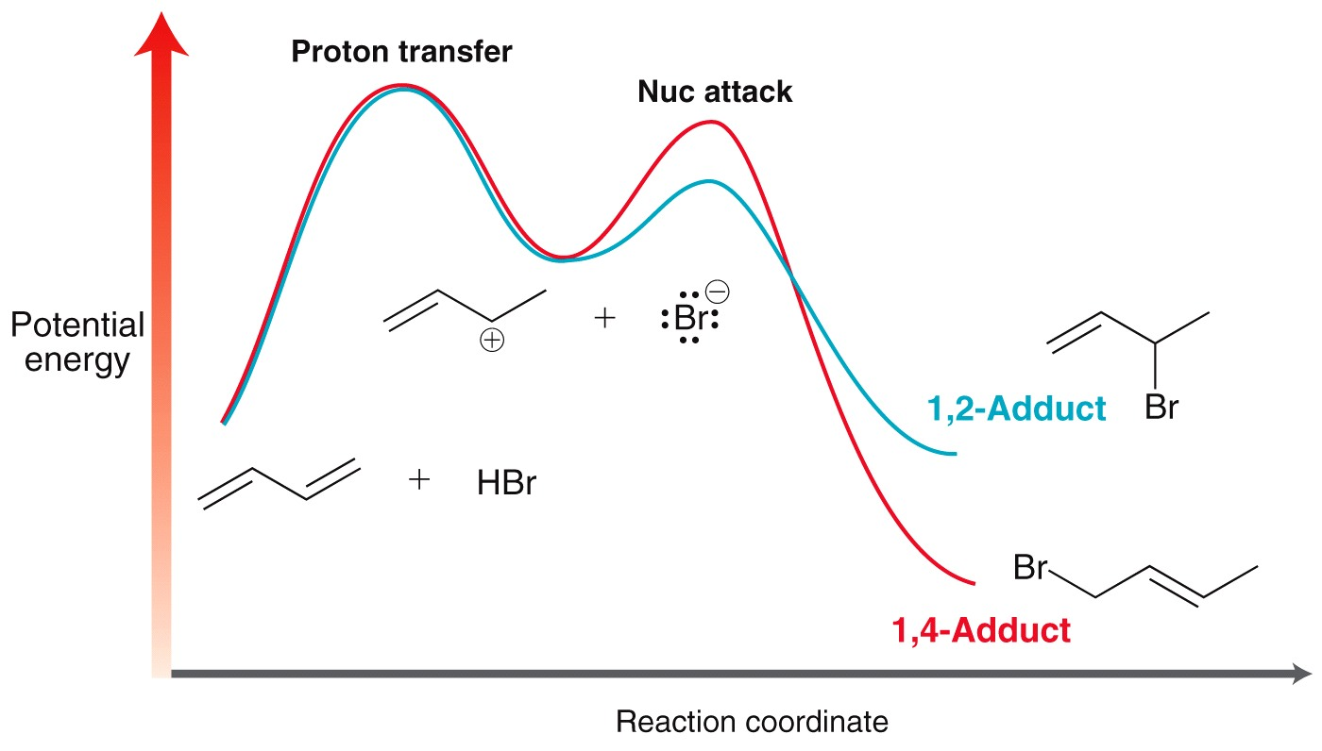
ADDITION TO CONJUGATED DIENES
Kinetic vs. Thermodynamic Control

Slide 7
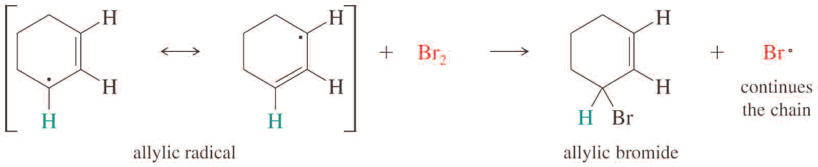
RADICAL REACTIONS
Allylic Radicals
Like allylic cations, allylic radicals are tabilized by resonance.
Radical stabilities: 1° < 2° < 1° allylic < 3° < 2° allylic .
Substitution at the allylic position competes with addition to double bond.
To encourage substitution, use a low concentration of reagent with light, heat, or peroxides to initiate free radical formation.
Allylic Bromination

Slide 8
RADICAL REACTIONS
Allylic Bromination
What about this?

Slide 9
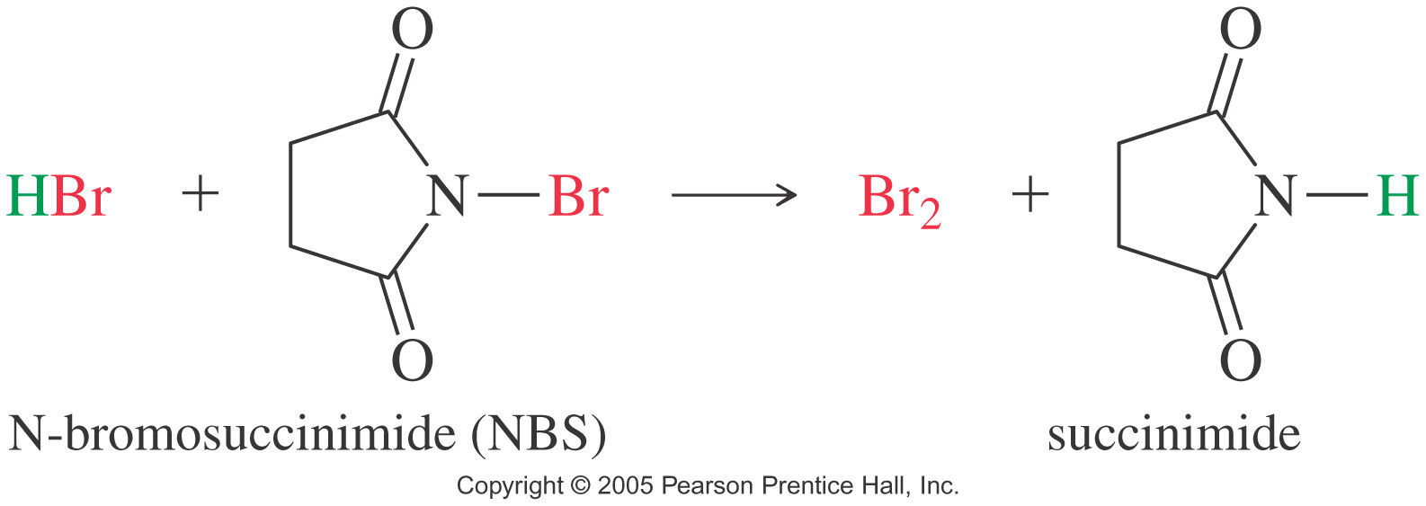
RADICAL REACTIONS
Allylic Bromination
This reaction can also be promoted using NBS (N-bromosuccinimide) in HBr.
NBS provides a low, constant concentration of Br₂ by reacting with the HBr by-product to produce Br₂ used in the allylic bromination step and prevents HBr addition.

Slide 10
ALLYLIC AND BENZYLIC CARBOCATIONS
Conjugated compounds undergo a variety of reactions, many of which involve intermediates that retain some of the resonance stabilization of the conjugated system.
Common intermediates include allylic and benzylic systems.
Allylic Cations
Carbon adjacent to C=C is allylic. Allylic cation is stabilized by resonance.
Stability of 1° allylic ≈ 2° carbocation. Stability of 2° allylic ≈ 3° carbocation
H₃C⁺ < 1° < 2°, 1° allyl < 3°, 2° allylic

Slide 11
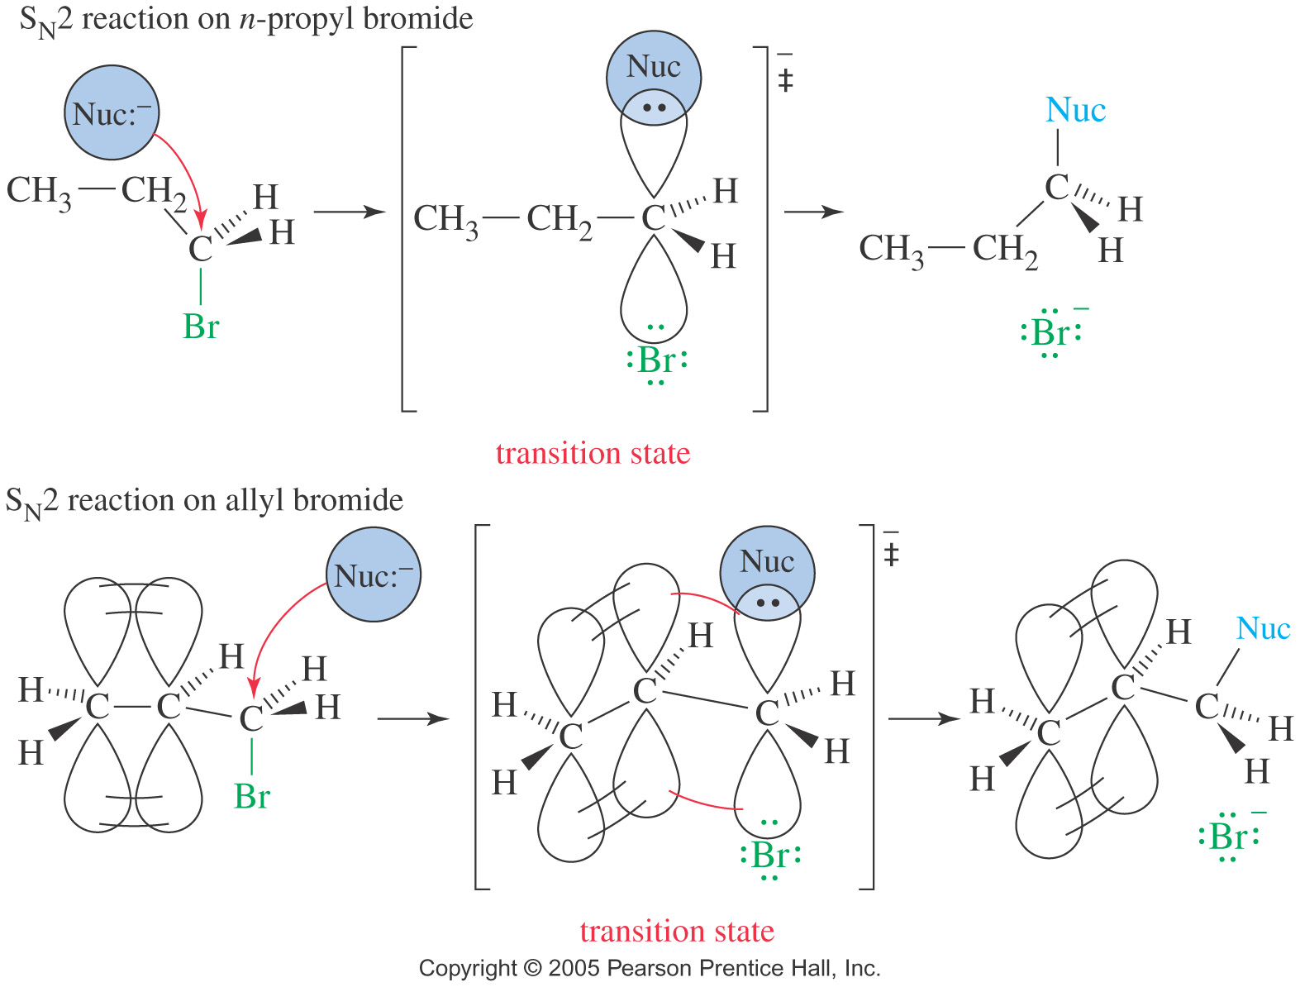
S_{N}2 REACTIONS OF ALLYLIC HALIDES
Allylic halides and tosylates show enhanced reactivity toward nucleophilic displacement reactions by the S_{N}2 mechanism. For example, allyl bromide reacts with nucleophiles by the S_{N}2 mechanism about 40 times faster than n-propyl bromide.

Slide 12
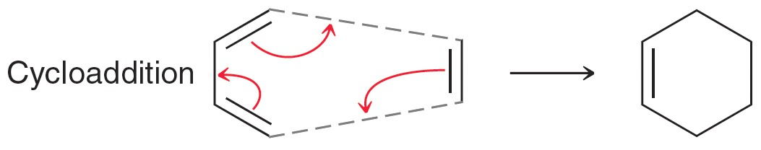
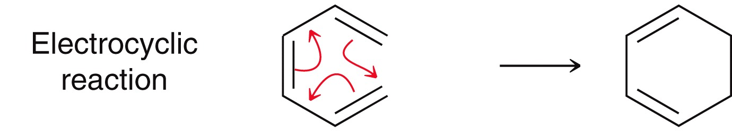
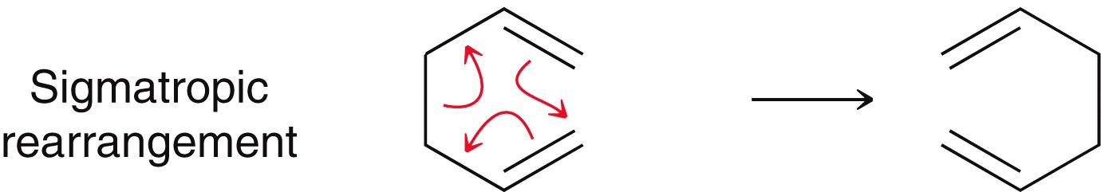
PERICYCLIC REACTIONS
Pericyclic reactions occur without ionic or free radical intermediates. There are three main types of pericyclic reactions
Cycloaddition reactions
Electrocyclic reactions
Sigmatropic rearrangements

Slide 13
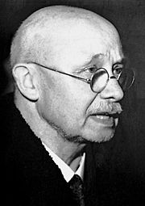
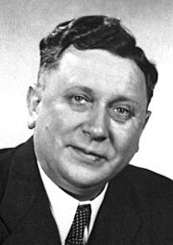
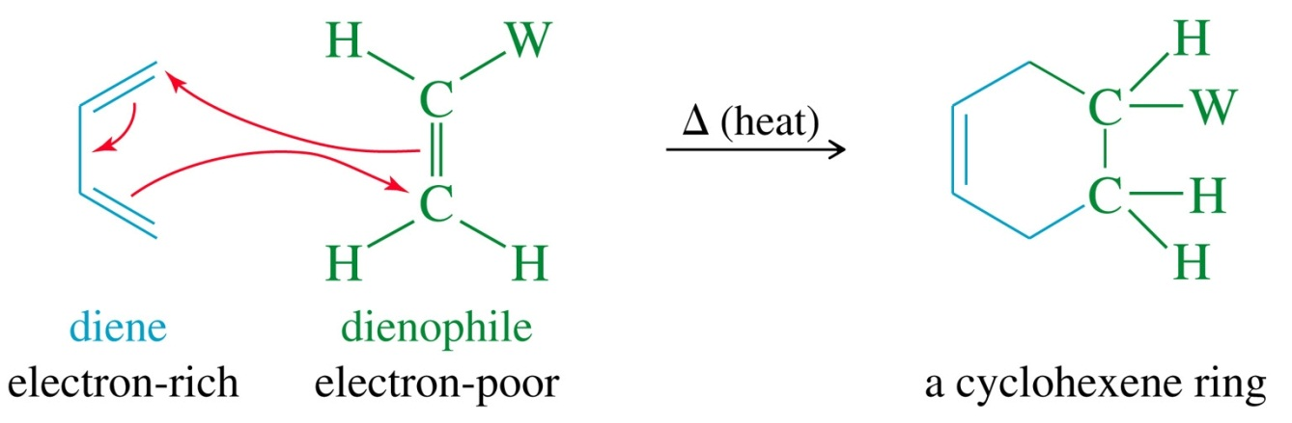
THE DIELS-ALDER REACTION
In 1928, German chemists Otto Diels and Kurt Alder discovered that alkynes and alkenes carrying electron-withdrawing groups add to conjugated dienes to form six-membered rings. They were awarded the Nobel Price in 1950 for their work.
Otto Paul Hermann Diels (23 January 1876 – 7 March 1954) was a German chemist and co-winner of the 1950 Nobel Prize in Chemistry with his student Kurt Alder.
Kurt Alder (10 July 1902 – 20 June 1958) German chemist and Nobel Prize winner.

Slide 14
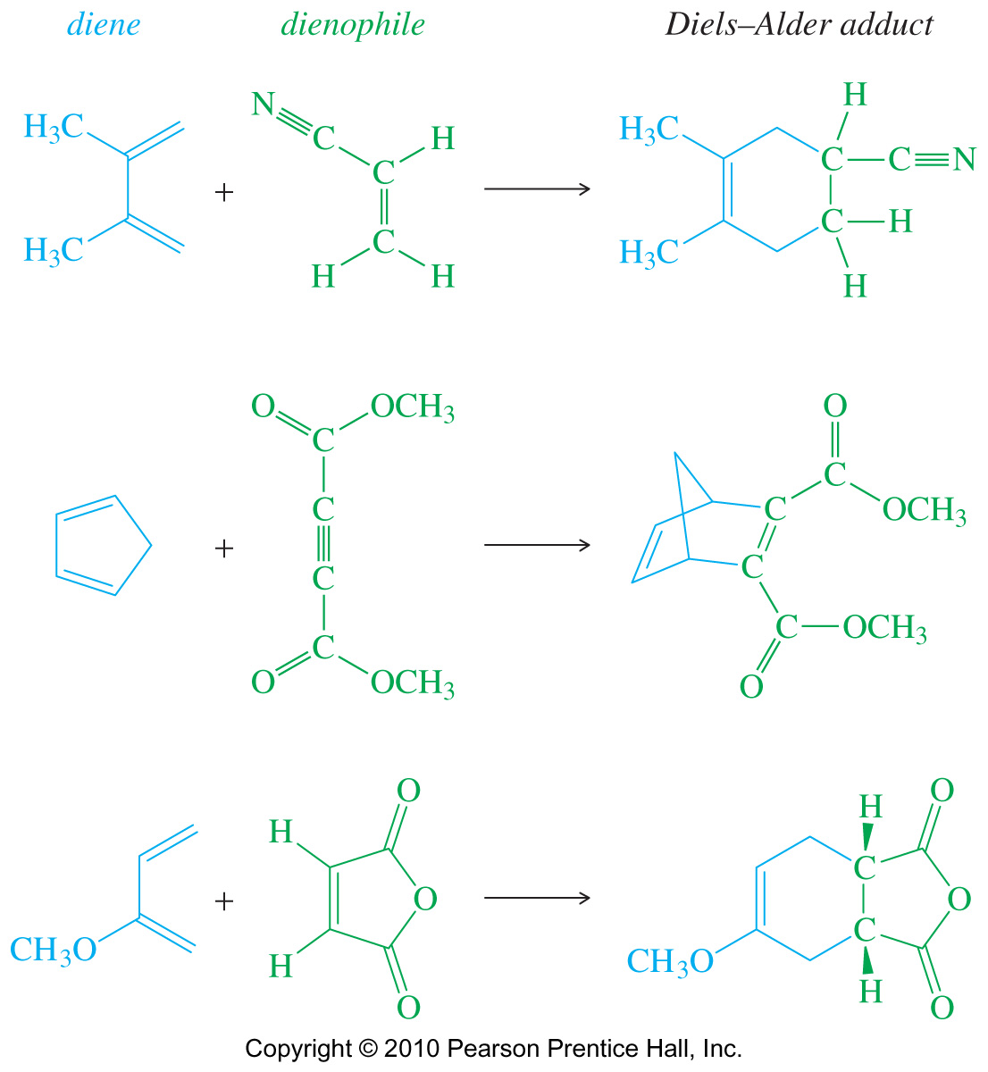
THE DIELS-ALDER REACTION

Slide 15
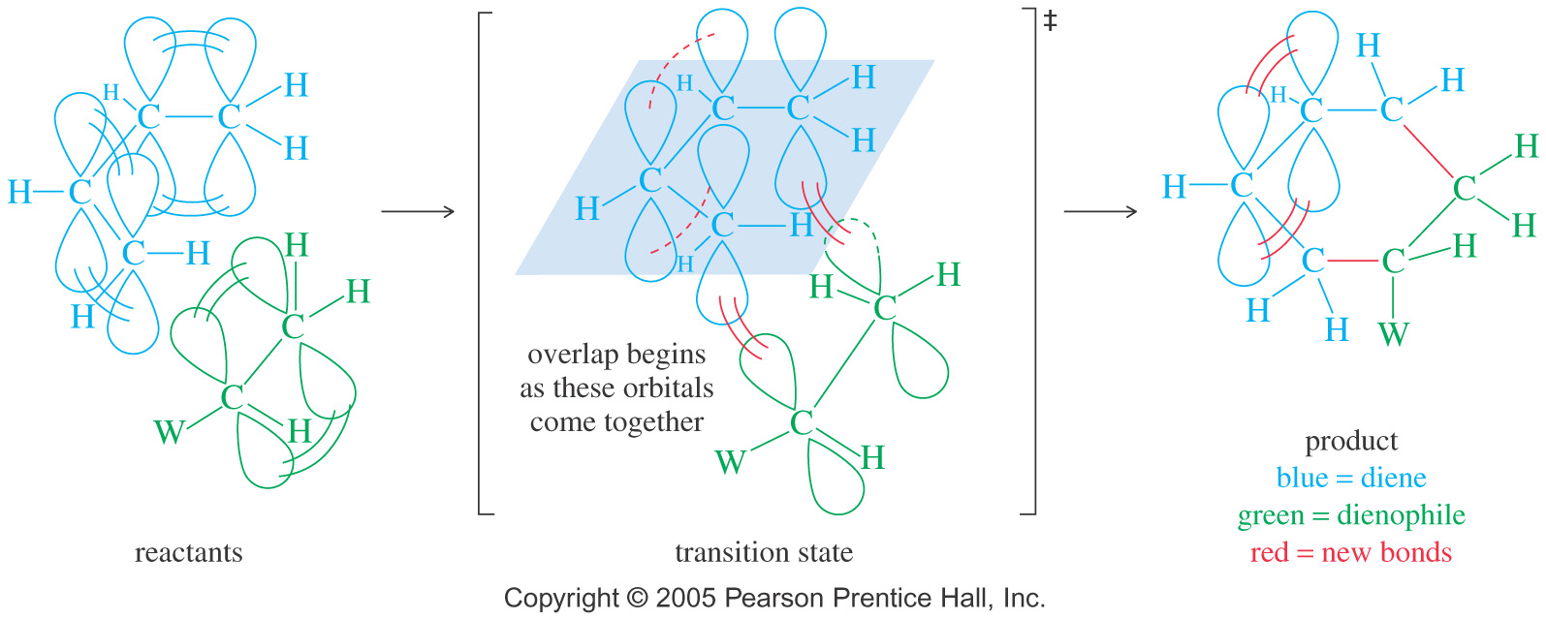
THE DIELS-ALDER REACTION
Requirements
Diene must be in s-cis conformation.
Diene’s C1 and C4 p orbitals must overlap with dienophile’s p orbitals to form new sigma bonds.
Both sigma bonds are on same face of the diene: syn stereochemistry
The dienophile need to carry an electron- withdrawing group for better reactivity
(W = CHO, COR, COOH, COCl, CN, NO₂, Ar, CH₂OH, CH₂Cl, CH₂NH₂, halogen etc…)

Slide 16
THE DIELS-ALDER REACTION
Other family of compounds carrying heteroatomic multiple bonds can also be used as dienophiles.
For dienes, they come in different structural types, linear, cyclic, bicyclic etc… the only requirement is that the multiple bonds must be conjugated, and must be in their cisoidal conformation.
Practice 17.14 to 17.16 P. 801, 17.19 P. 803
Problems 17.40, 17.41, 17.43, 17.44 P. 827

Slide 17
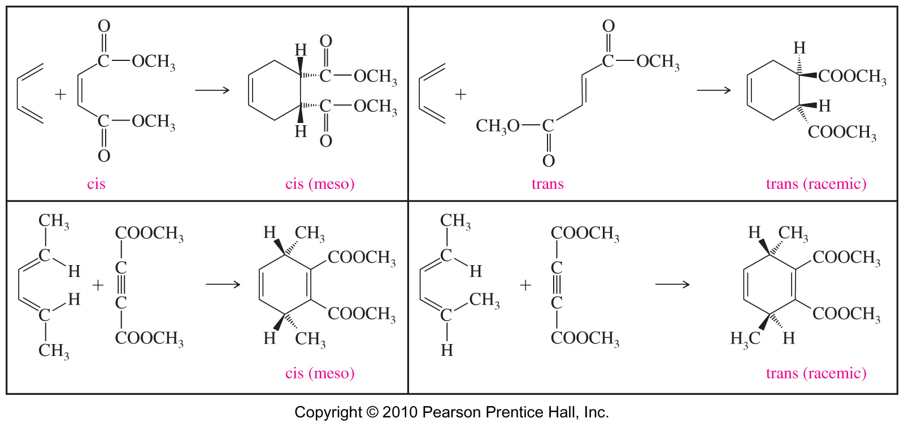
THE DIELS-ALDER REACTION
Stereochemistry of the Diels–Alder Reaction
The stereochemistry of the diene and the dienophile is maintained during the course of the reaction

Slide 18
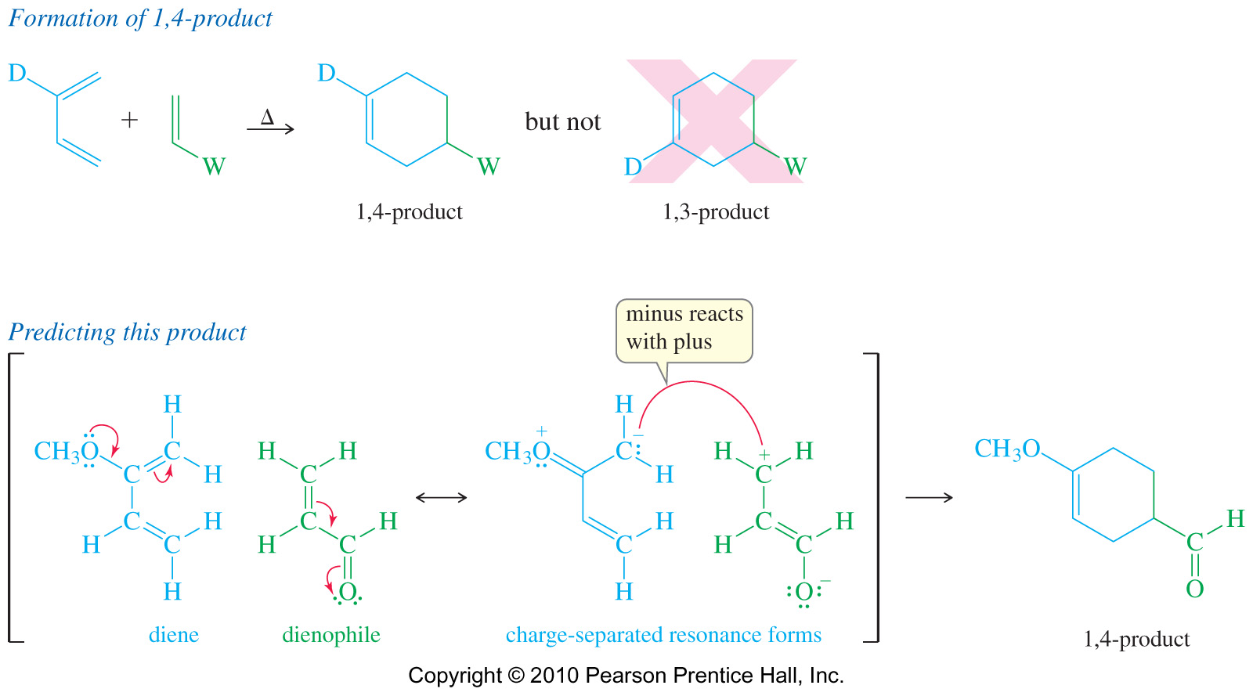
THE DIELS-ALDER REACTION
The mechanism: Regiospecificity
Even when the diene and dienophile are both unsymmetrically substituted, the Diels-Alder reaction usually gives a single product (or a major product) rather than a random mixture.
The 6-membered ring product of the Diels-Alder reaction will have electron-donating and electron-withdrawing groups 1,2 or 1,4 but not 1,3.

Slide 19
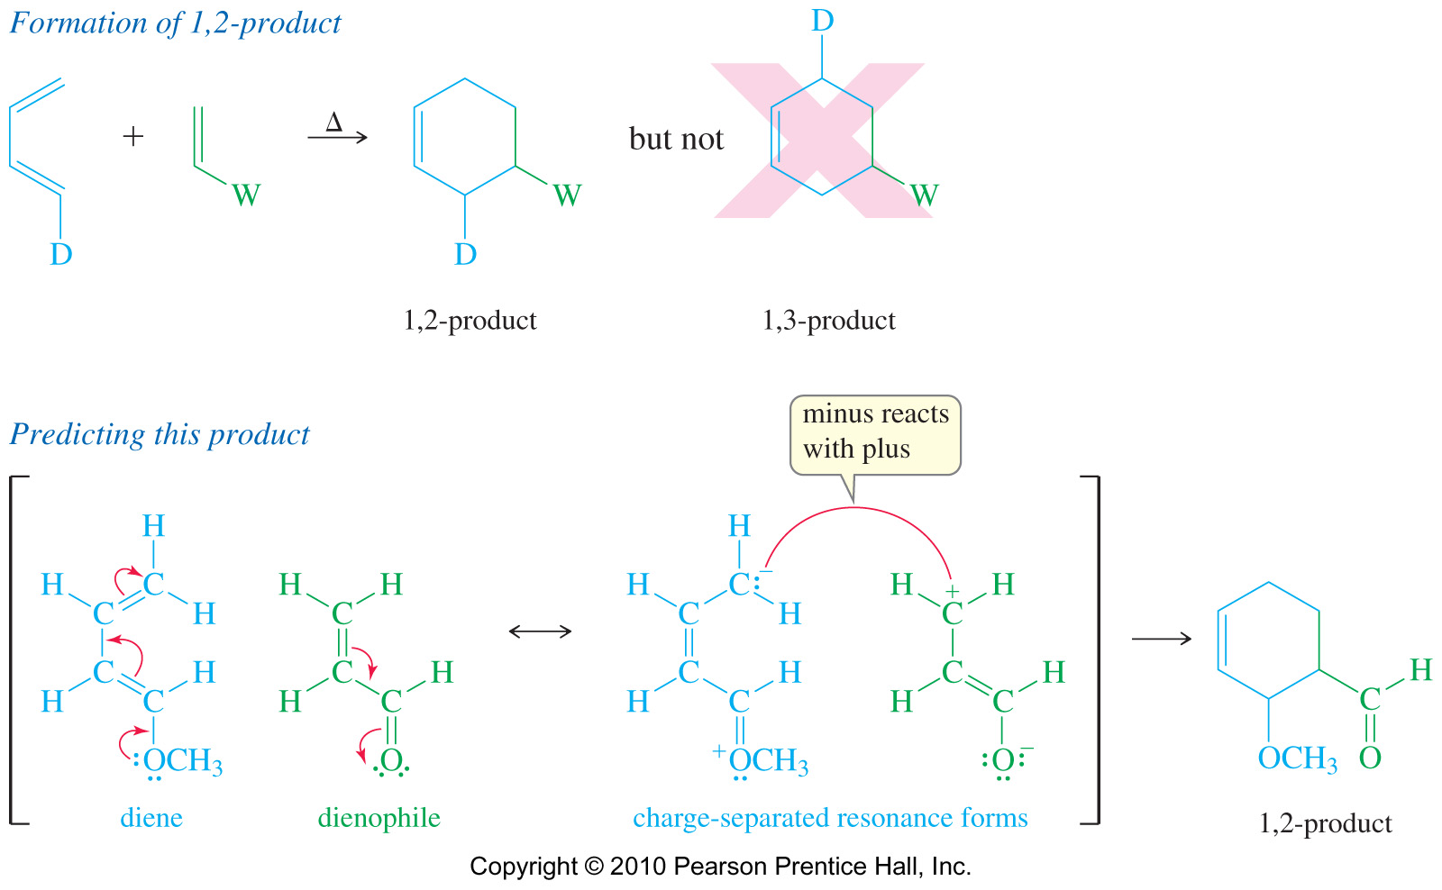
THE DIELS-ALDER REACTION
Unsymmetrical Reagents: 1,2-Product

Slide 20
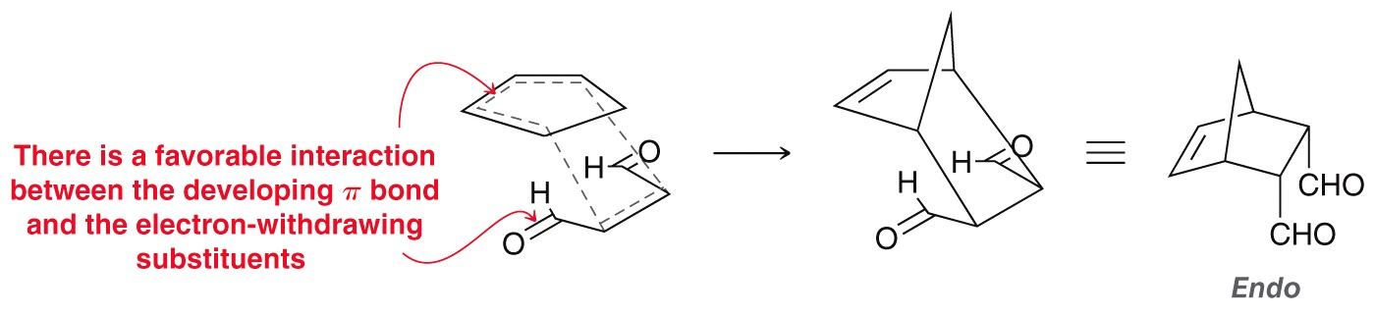
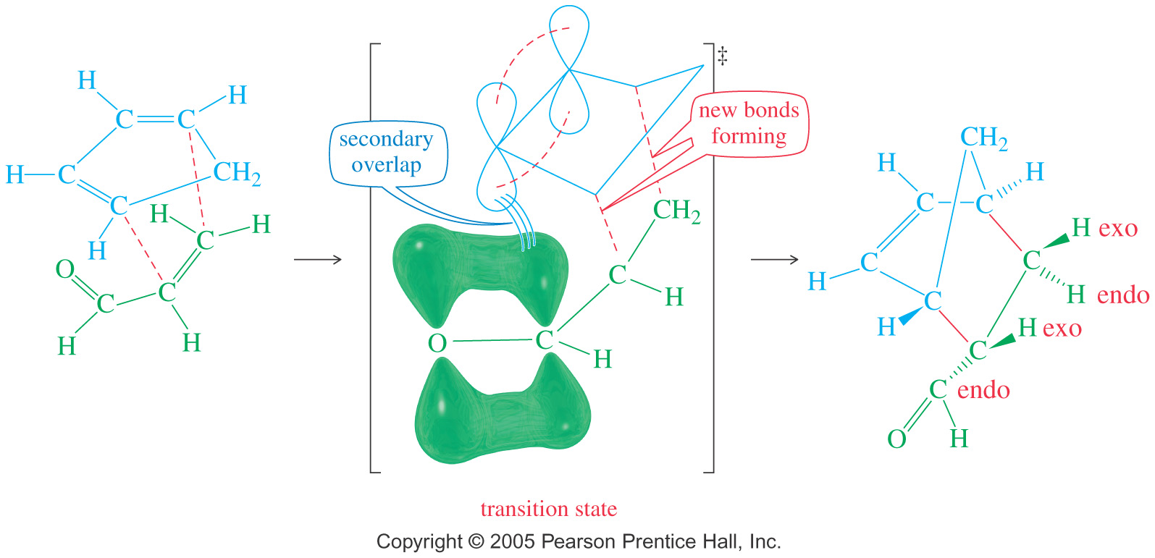
THE DIELS-ALDER REACTION
The mechanism: the endo rule
When the dienophile has a pi bond in its electron-withdrawing group (carbonyl or cyano group), the p orbitals in that electron-withdrawing group approach one of the central carbon atoms (C2 or C3) of the diene, and this results in secondary overlap. The overlap helps stabilize the transition state.

Slide 21
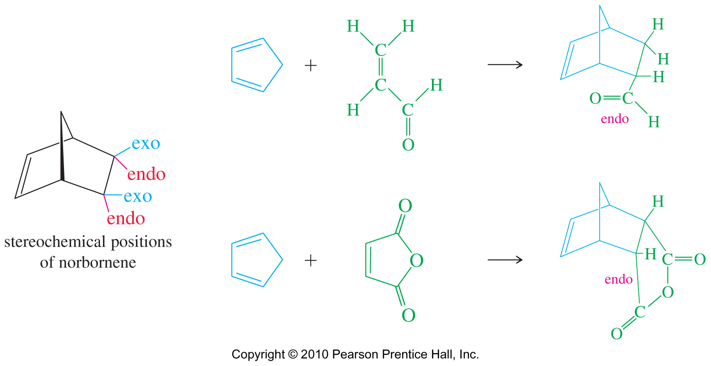
THE DIELS-ALDER REACTION
Examples

Slide 22
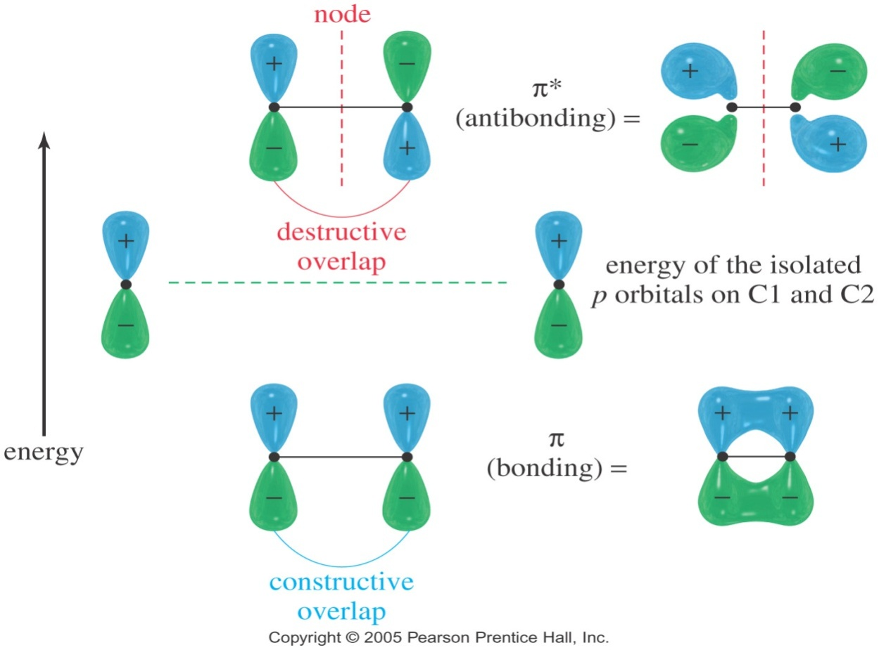
MOLECULAR ORBITALS
Constructing the molecular orbitals of ethene
MO Energy Diagram: The average energy of electrons is lower in the conjugated compound.
p orbitals have 2 lobes: (+) and (-) indicate the opposite phases of the wave function, not electrical charge.
Pi molecular orbitals are the sideways overlap of p orbitals.
When lobes overlap constructively, (+ and +, or - and -) a bonding MO is formed.
When + and - lobes overlap, waves cancel out and a node forms; antibonding MO.
The combination of two p orbitals must give two molecular orbitals.
Constructive overlap is a bonding MO.
Destructive overlap is an anti-bonding MO

Slide 23
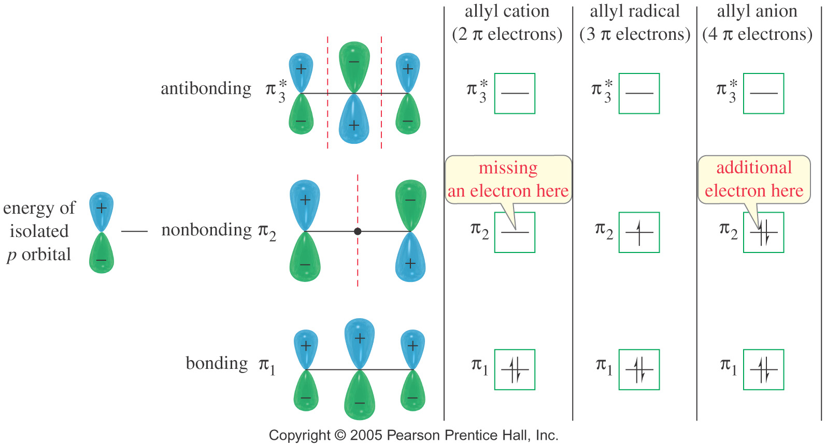
MOLECULAR ORBITALS
Molecular obitals for reactive intermediates: cations, radicals and anions

Slide 24
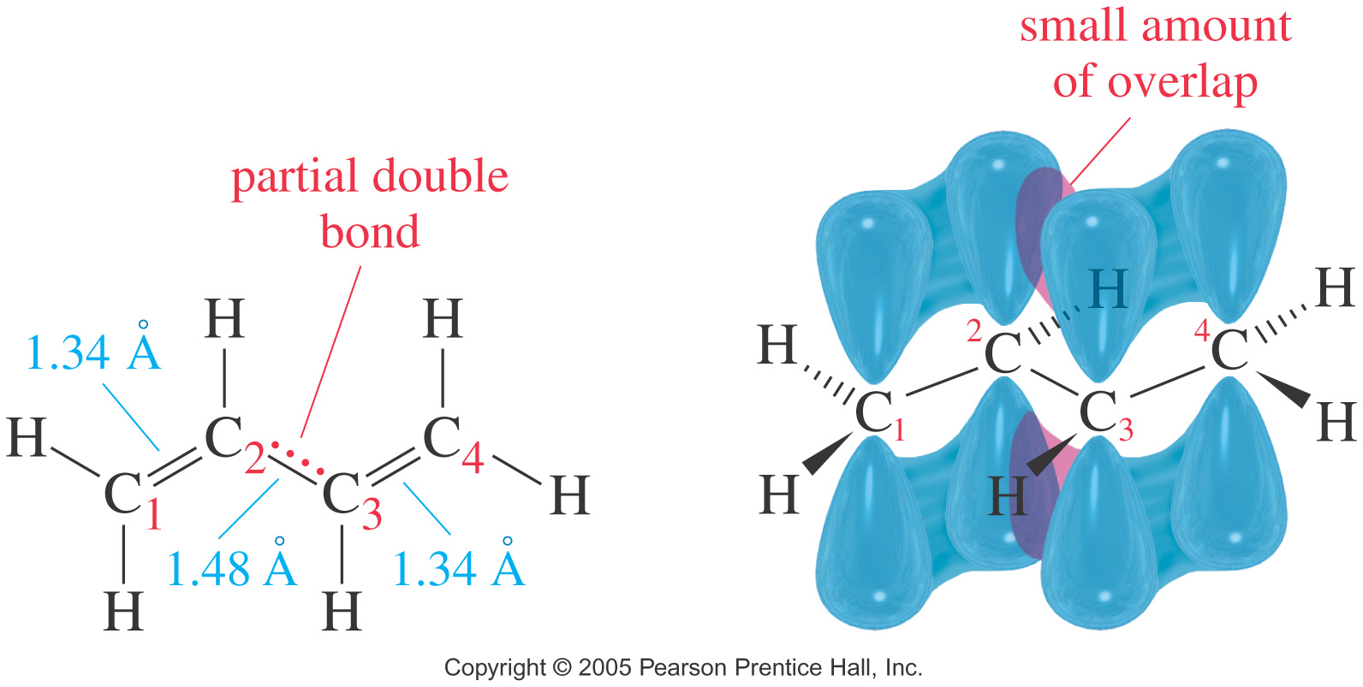
MOLECULAR ORBITALS
Structure of Butan-1,3-diene
The most stable conformation of 1,3-butadiene is planar.
The C2-C3 single bond is shorter than the C-C single bonds in alkanes (1.54 Å). This is because electrons in the two double bonds are delocalized over the entire molecule.

Slide 25
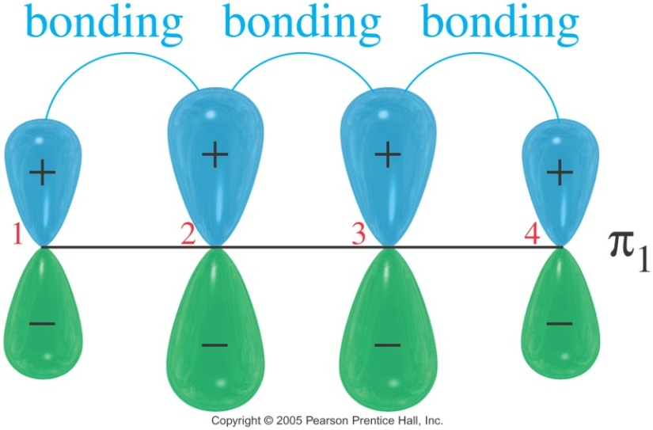
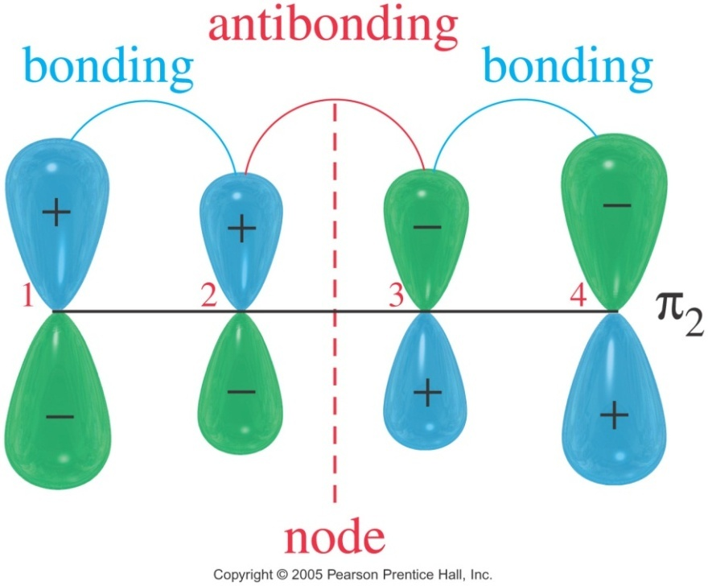
MOLECULAR ORBITALS
Constructing the molecular orbitals of Butan-1,3-diene
π₁ MO for 1,3-Butadiene
The lowest-energy molecular orbital always consists entirely of bonding interactions. Electrons are delocalized over four nuclei.
π₂ MO for 1,3-Butadiene
This MO has 2 bonding interactions and 1 antibonding interaction.
This is a bonding MO, but not as strong as π₁

Slide 26
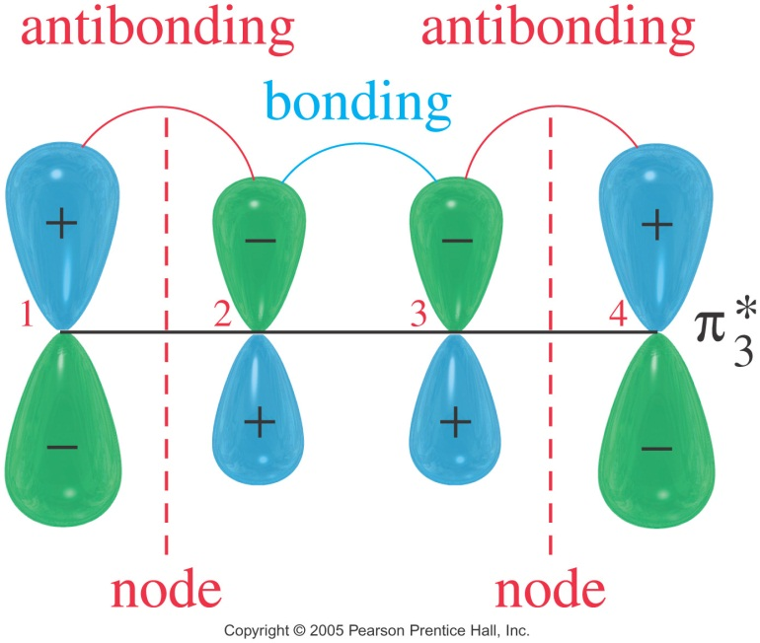
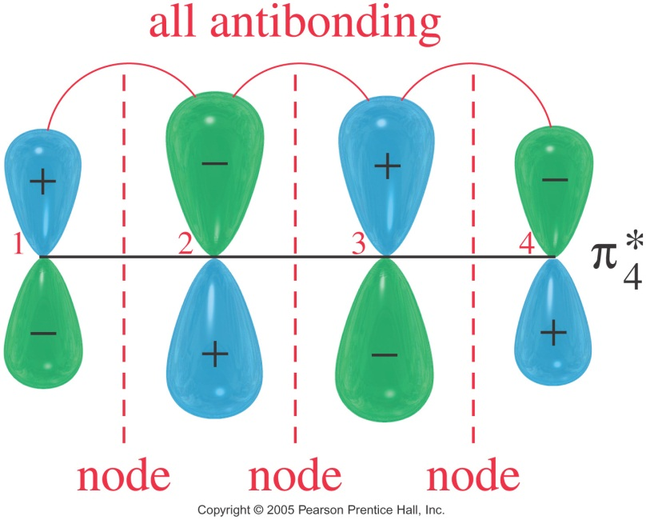
MOLECULAR ORBITALS
π₃* MO for 1,3-Butadiene
The third MO of 1,3-butadiene has two nodes, giving 2 antibonding interactions and 1 bonding interaction.
This is an antibonding MO, and is vacant in the ground state
π₄* MO for 1,3-Butadiene
The fourth and the highest MO of 1,3-butadiene has three nodes and three antibonding interactions.
It is strongly antibonding, and is vacant in the ground state

Slide 27
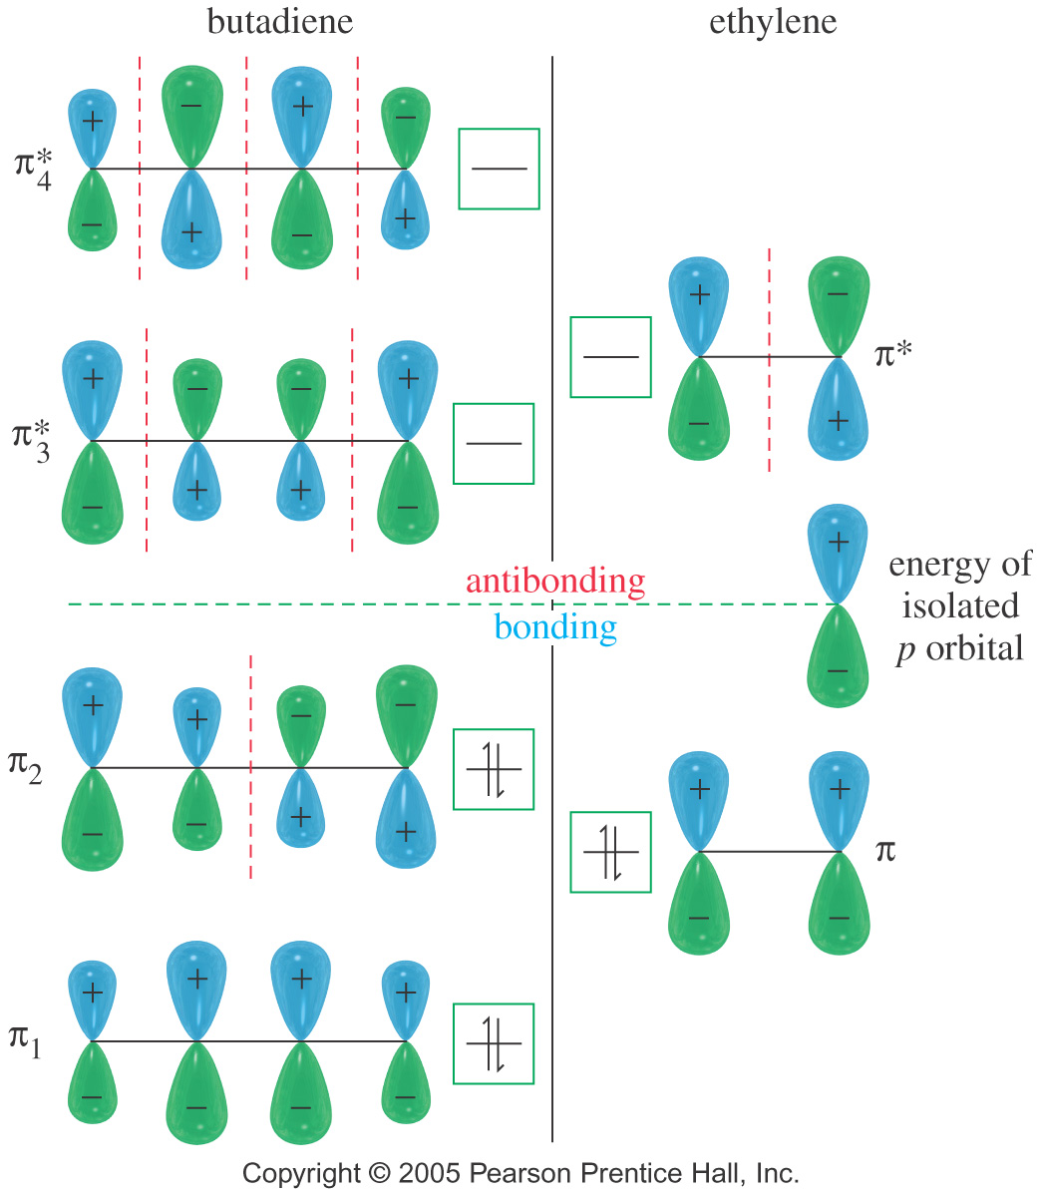
MOLECULAR ORBITALS
The mechanism of the Diels-Alder reaction
Conformations of 1,3-Butadiene
The trans conformer is more stable than the cis by 12 kJ/mol (2.8 kcal/mol).
They easily interconvert at room temperature

Slide 28
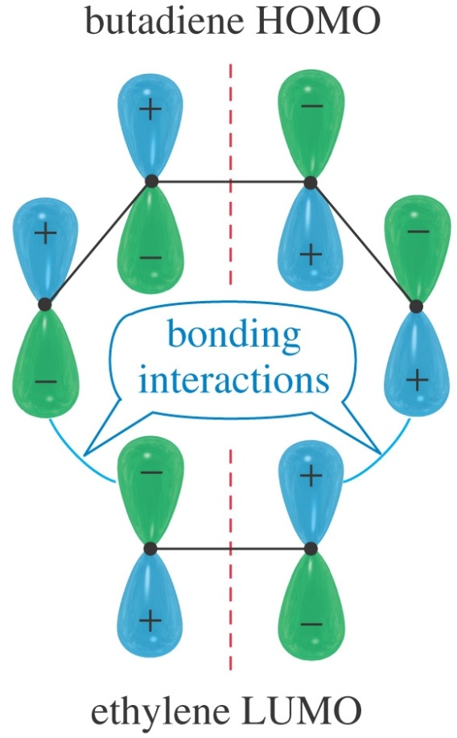
MOLECULAR ORBITALS
The mechanism of the Diels-Alder reaction
Around 1965, Woodward and Hoffmann developed a theory for predicting the results of pericyclic reactions using their theory of conservation of orbital symmetry.
MO’s must overlap constructively to stabilize the transition state
Symmetry-Allowed Reaction
Diene contributes electrons from its highest energy occupied orbital (HOMO).
Dienophile receives electrons in its lowest energy unoccupied orbital (LUMO).

Slide 29
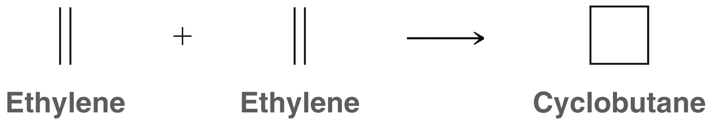
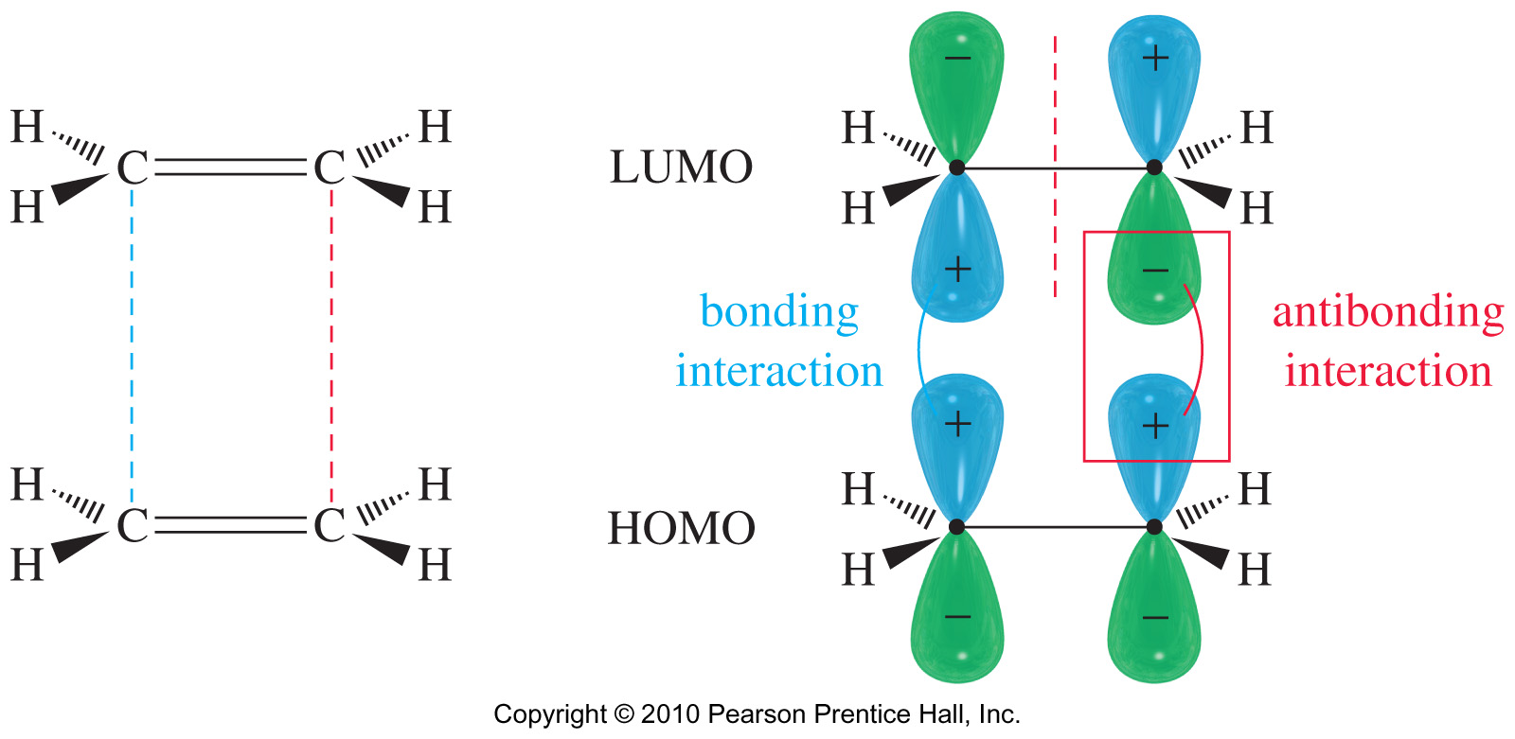
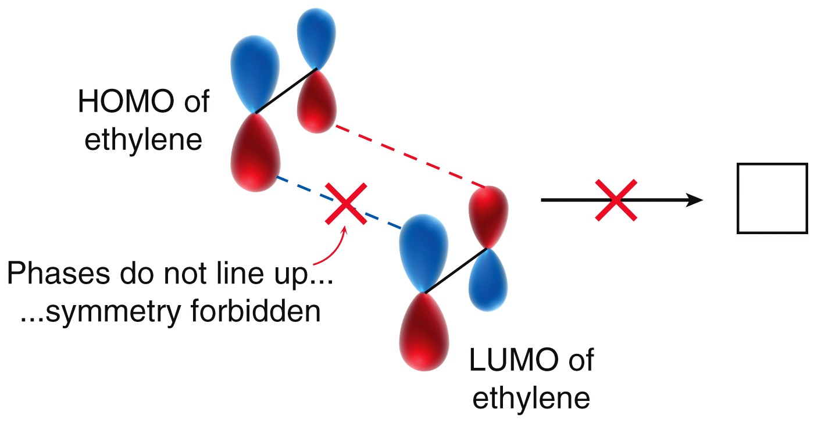
MOLECULAR ORBITALS
The “Forbidden” [2 + 2] cycloaddition
When a cycloaddition produces an overlap of positive-phase orbitals with negative phase orbitals (destructive overlap), antibonding interactions are generated. These interactions raise the activation energy; thus this reaction is classified as symmetry-forbidden.
[2 + 2] cycloaddition of two ethylenes to form cyclobutene has anti-bonding overlap of HOMO and LUMO; it is a symmetry-forbidden reaction.

Slide 30
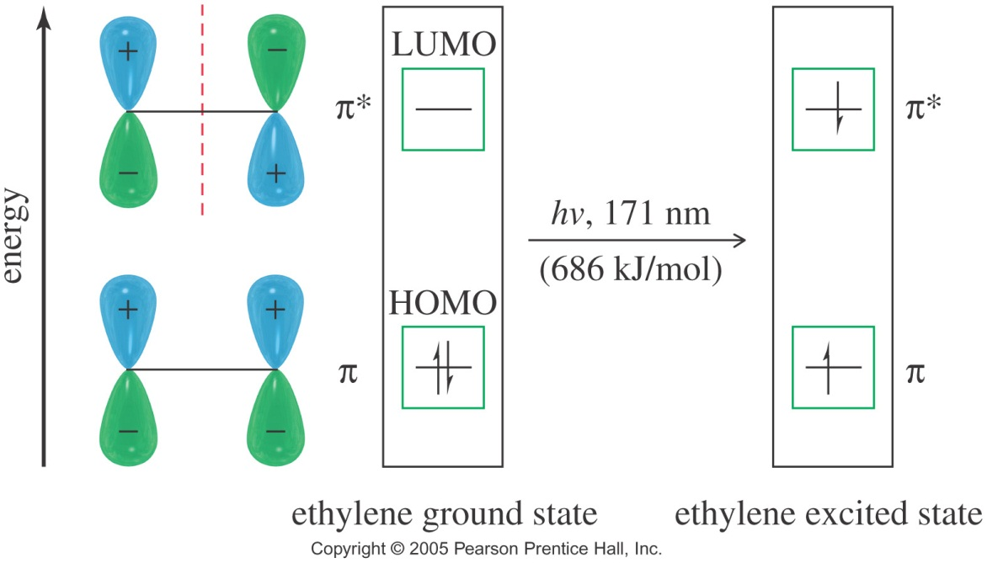
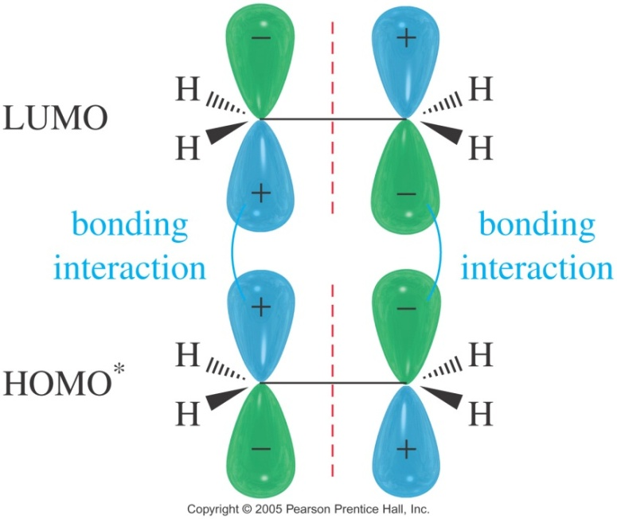
MOLECULAR ORBITALS
Photochemical Induction
Absorption of correct energy photon will promote an electron to an energy level that was previously unoccupied.
[2 + 2] Cycloaddition are thermally forbidden, but photochemically allowed

Slide 31
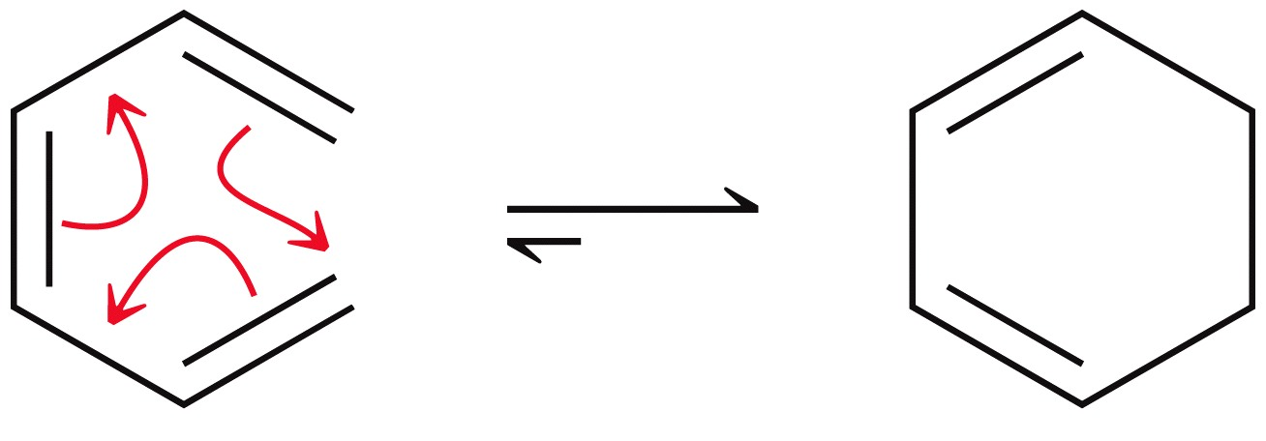
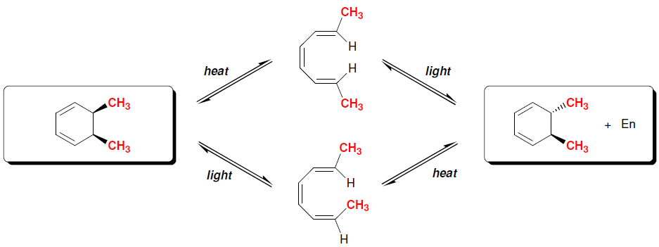
Electrocyclic reactions
When substituents are present on the terminal carbons, stereoisomers are possible. The use of light versus heat gives different products.
Often the energy present at room temperature is sufficient to promote thermal electrocyclic reactions. However, with the use heat, the configuration of the reactant determines the product formed.
Practice 17.22, 17.23 P. 811

Slide 32
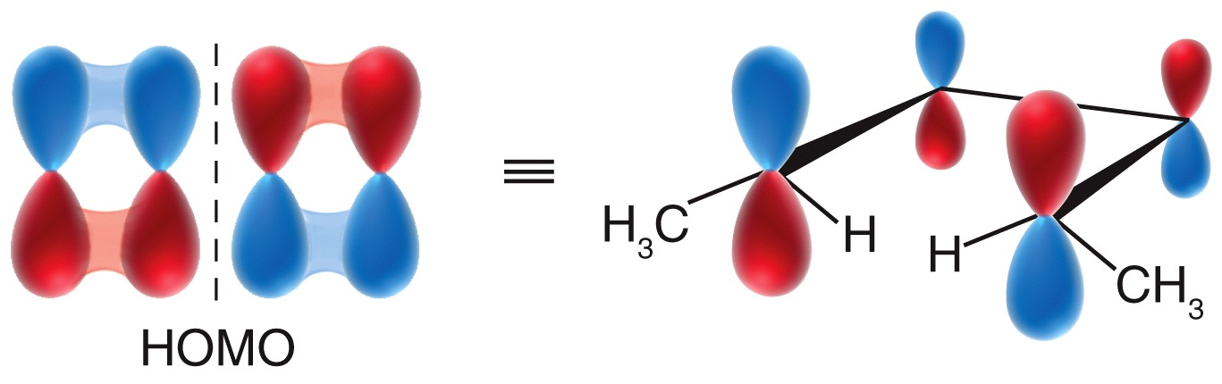
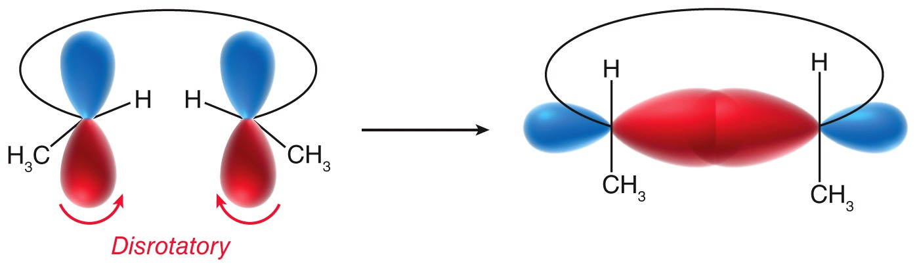
Electrocyclic reactions
The symmetry of the HOMO determines the outcome. The terminal carbons rotate as they become sp³ hybridized and overlap lobes that are in phase.
Disrotatory rotation (one rotates clockwise and the other counterclockwise) gives the cis product.

Slide 33
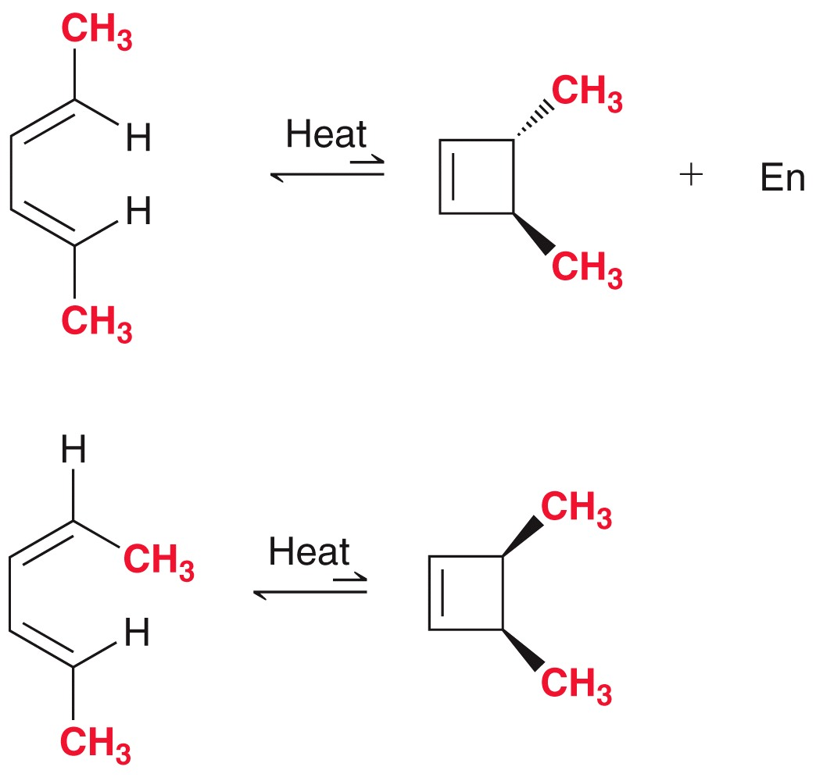
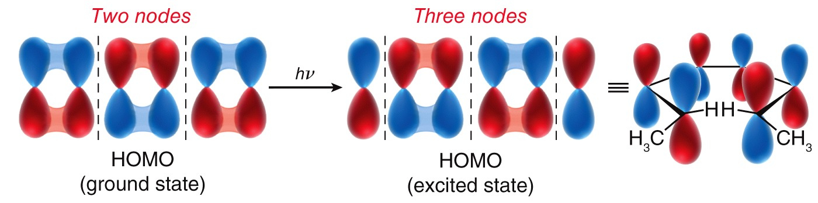
Electrocyclic reactions
Under photochemical conditions, light energy excites an electron from the HOMO to the LUMO, and What was the LUMO becomes the new HOMO.
The disrotatory nature of the photochemical [2+2] electrocyclic ring-closing is difficult to observe directly, because the thermodynamically favors ring opening. Thus, the ring-opening reaction gives products that result from disrotatory rotation.

Slide 34
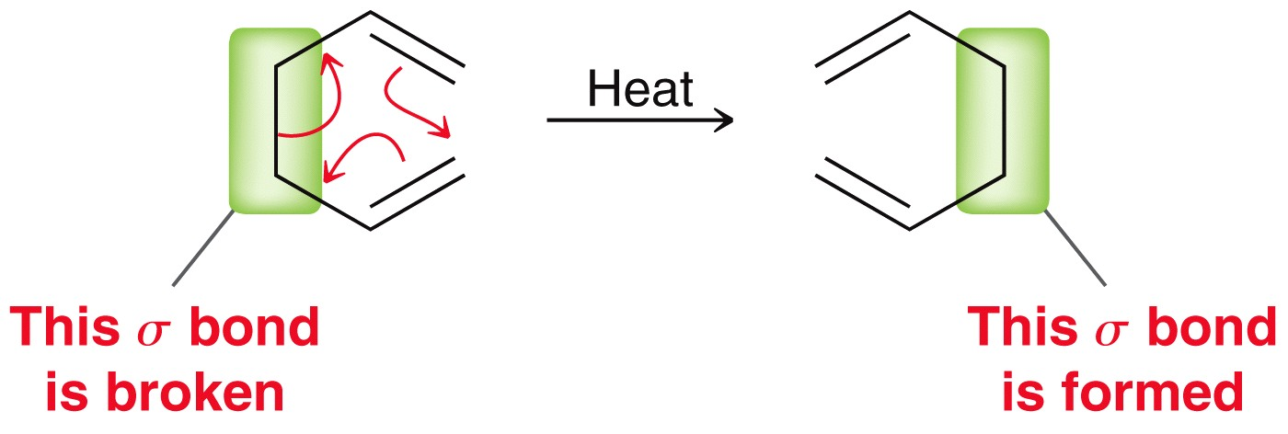
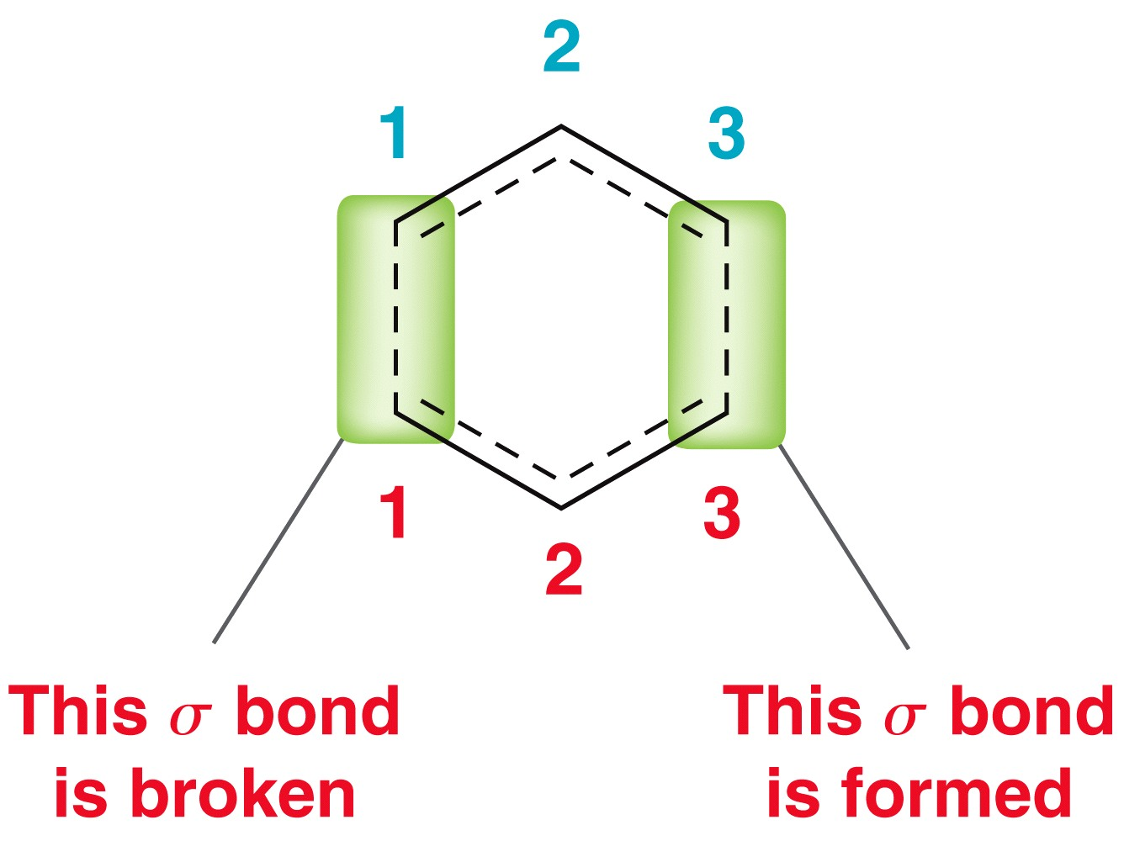
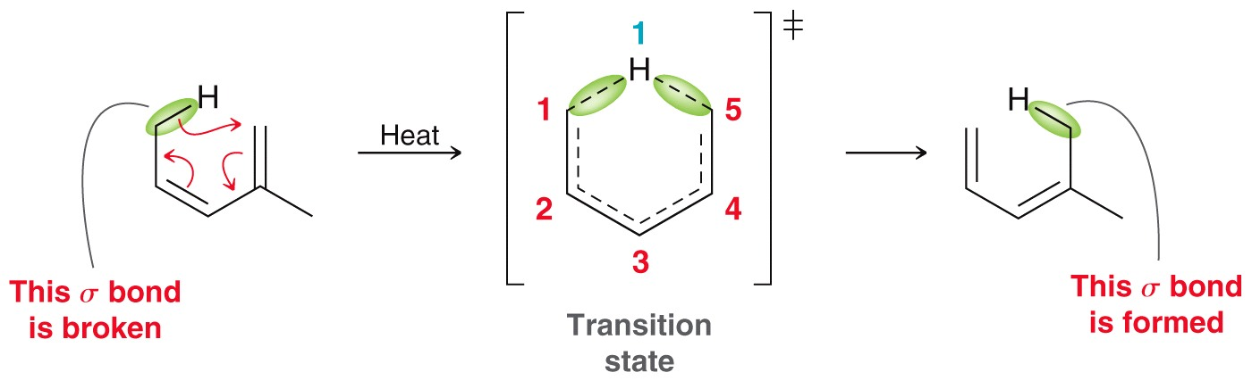
Sigmatropic Rearrangements
Sigmatropic Rearrangements – a pericyclic reaction in which one sigma bond is replaced with another
For the notation for sigmatropic rearrangements, one must count the number of atoms on each side of the sigma bonds that are breaking and forming
This is a [3,3] sigmatropic rearrangement
Practice 17.25, 17.27 P.813
Problems 17.56, 17.57, 17.59 P. 828
The reaction below is a [1,5] sigmatropic rearrangement

Slide 35
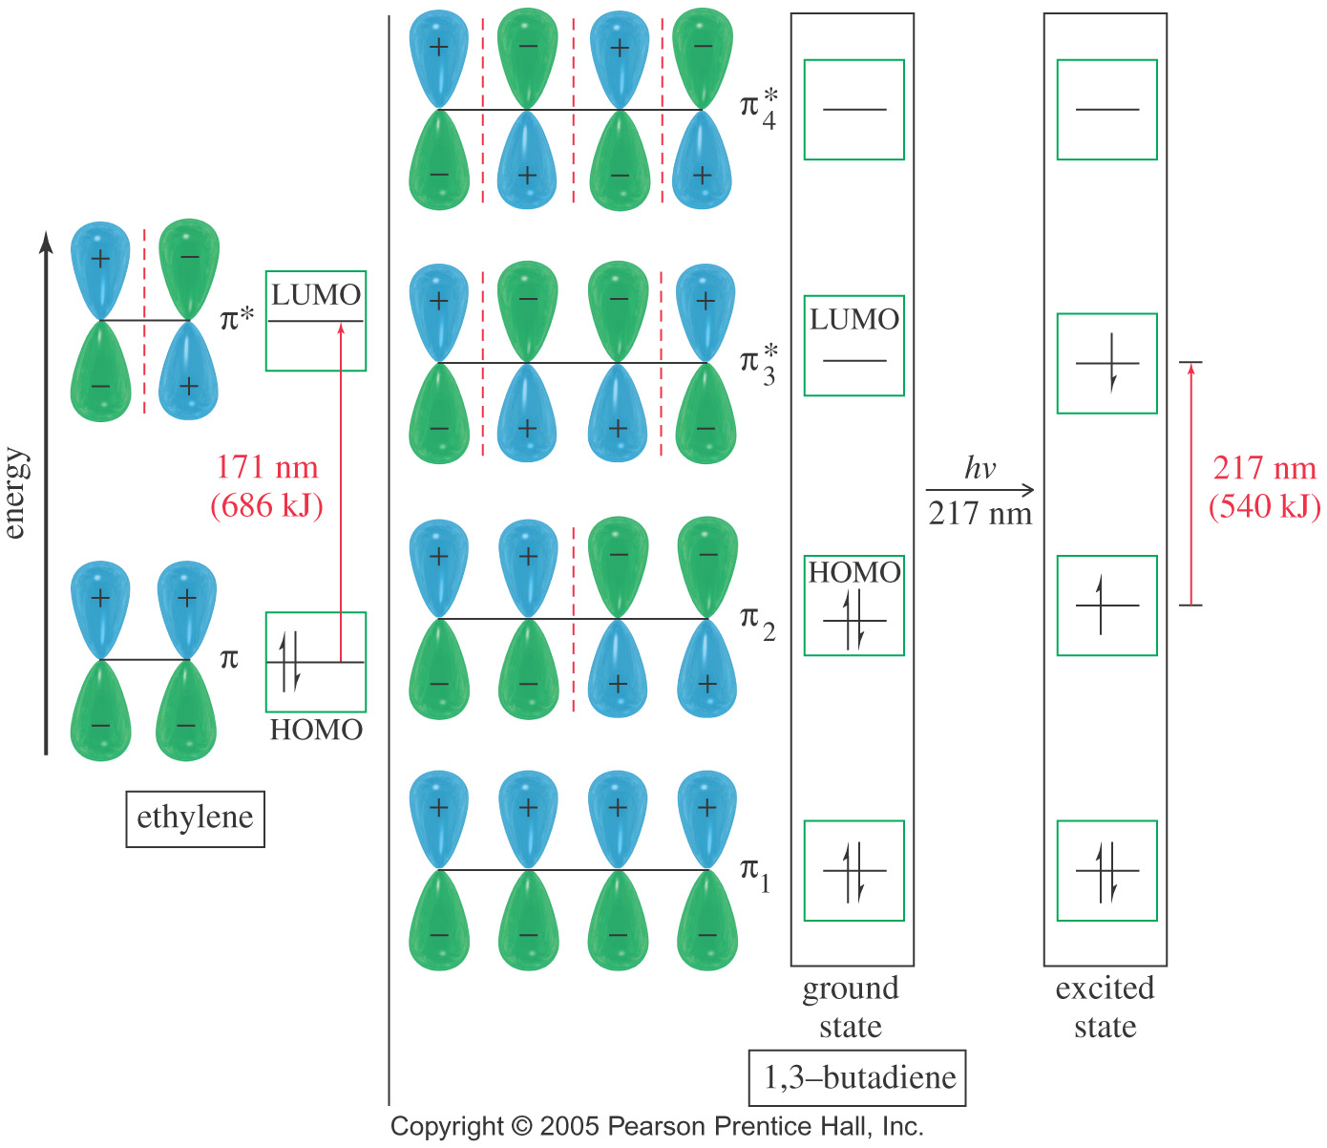
→ π* for ethylene and butadiene
ULTRAVIOLET SPECTROSCOPY
When a molecule absorbs at its longest wavelength, an electron is excited from its HOMO to its LUMO.
For most alkenes and alkadienes, the HOMO is a bonding (π) orbital and the LUMO an antibonding (π*) orbital.
In general, the greater the number of conjugated multiple bonds in a molecule, the longer will be the its λ_{max} and the lower the transition energy.
Alkenes and nonconjugated dienes usually absorb at λ_{max} below 200 nm
Conjugated dienes absorb at λ_{max} longer than 200 nm

Slide 36
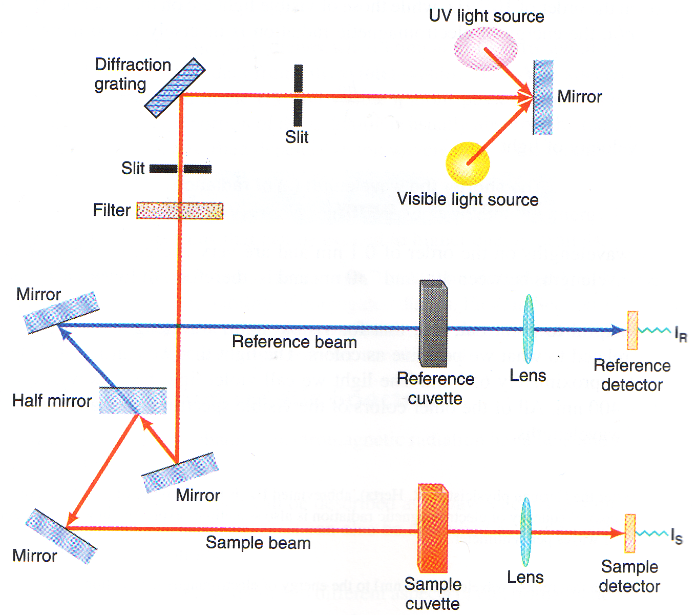
ULTRAVIOLET SPECTROSCOPY
Uv-Vis spectrophotometer measures the amount of light absorbed by a sample at each wavelength of the UV and visible regions of the electromagnetic spectrum.

Slide 37
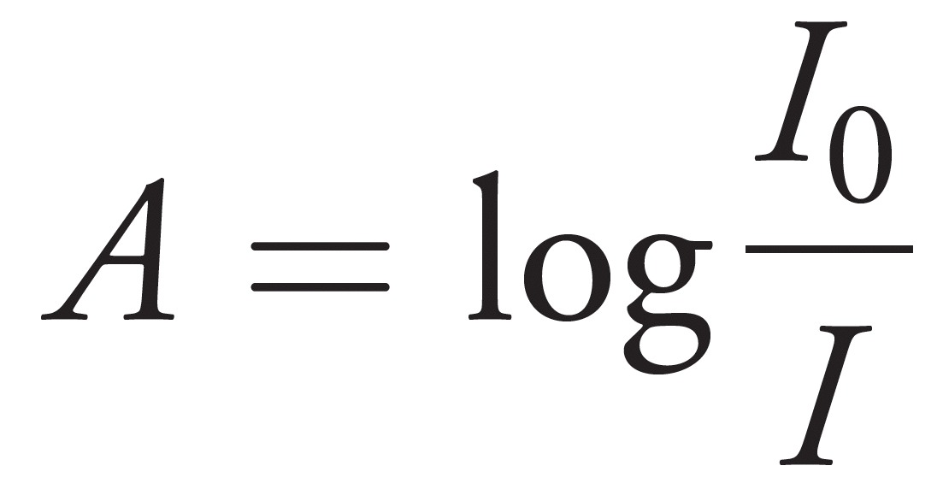

ULTRAVIOLET SPECTROSCOPY
Obtaining a UV Spectrum
The spectrometer measures the intensity of a reference beam through solvent only (Ir) and the intensity of a beam through a solution of the sample (Is).
Absorbance is the log of the ratio.
Avobenzene is an example of a molecule used in sunscreens that absorbs light with λ_{max} = 360 nm (blocks UVA), while Octyl methoxycinnamate has λ_{max}=310 nm, absorbing in the UVB range. UVC light, is even more energetic and potentially more hazardous to organisms. However, it is blocked by the atmosphere.

Slide 38

ULTRAVIOLET SPECTROSCOPY
UV Spectrum
Data from a UV-Vis spectrophotometer are represented as an absorption spectrum which is a graph of wavelength (λ) versus sample absorbance (A) at each wavelength in the spectral region of interest
Absorbance, A, follows Beer’s Law
A = εcl
ε = the molar absorptivity,
c = the sample concentration in mol/l
l = the length of the light path in centimeters

Slide 39
ULTRAVIOLET SPECTROSCOPY
The wavelengths of UV light absorbed by a molecule are determined by the electronic energy differences between orbitals in the molecule.
When the chromophore does not contain any double bond, the transition is (σ σ*) as in alkanes (λ_{max} are around 120 to 135 nm)
UV/Vis Absorption of conjugated Alkenes
The (π π*) transition of conjugated double bonds is above λ_{max} 200 nm with typical intensities of the order of logε ≈ 4.
The λ_{max} for a cross-conjugated system can be estimated using Woodward-Fieser rule

Slide 40



ULTRAVIOLET SPECTROSCOPY
The group of atoms responsible for absorbing UV-Vis light is known as the chromophore

Slide 41
ULTRAVIOLET SPECTROSCOPY
Woodward-Fieser rule for estimating the position (λ_{max}) of π-π* transition
Parent Systems Increments
Acyclic | 217 nm
Heteroannular | 214 nm
Homoannular | 253 nm
For each additional conjugated double bond | + 30 nm
For each exocyclic double bond | + 5 nm
For each substituent C-substituent Cl Br O-Alkyl OCOCH₃ N(alkyl)₂ S-alkyl | + 5 nm + 5 nm + 5 nm + 6 nm + 0 nm + 60 nm + 30 nm
Solvent correction | + 0 nm

Slide 42
ULTRAVIOLET SPECTROSCOPY
Estimate the position (λ_{max}) of π-π* transition for the following molecules using Woodward-Fieser rule
Practice 17.29, 17.30 p. 818
Problems 17.50 to 17.52 P. 828

